Slide 1
Lecture 7
Fourier Analysis

Slide 2
Objective:
Identifying even and odd function and their arithmetic combinations.
Periodic function and periodicity of a given function.
To know how to expand a periodic function in terms of an infinite sum of sines and (or) cosines, i.e. full range Fourier series in real form.

Slide 3
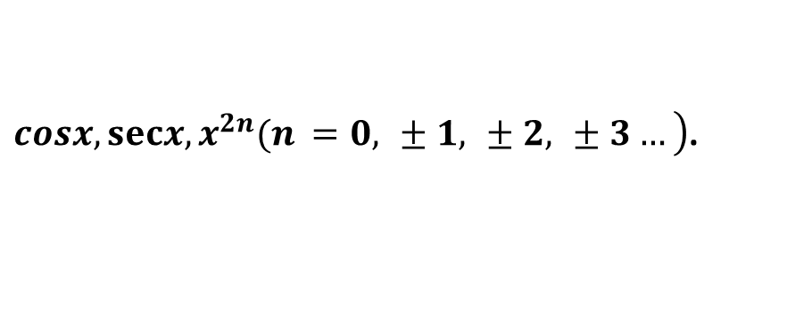
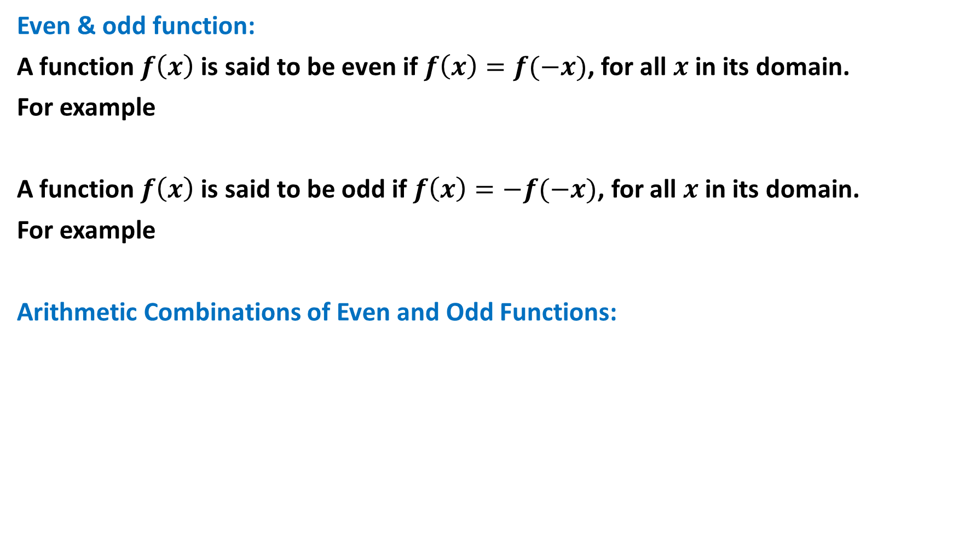
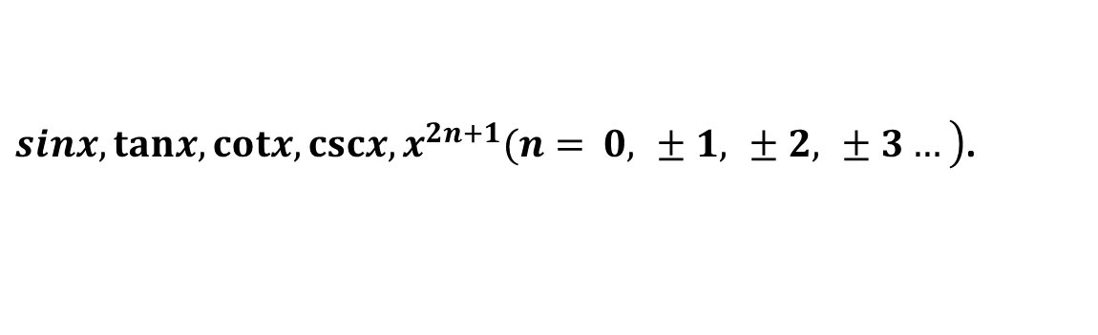
Even & odd function:
A function $f\left(x\right)$ is said to be even if $f\left(x\right)=f(−x)$, for all $x$ in its domain.
For example
A function $f\left(x\right)$ is said to be odd if $f\left(x\right)=−f(−x)$, for all $x$ in its domain.
For example
Arithmetic Combinations of Even and Odd Functions:
$\left.cosx,secx,x^{2n}(n =0, ±1, ±2, ±3…\right)$.
$\left.sinx,tanx,cotx,cscx,x^{2n+1}(n= 0, ±1, ±2, ±3…\right)$.
Operations | Even and Even | Odd and Odd | Even and Odd
+/- | Even | Odd | Neither
×/÷ | Even | Even | Odd

Slide 4



Calculus Properties of Even and Odd Functions:
When a function $g(x)$ is even and continuous on $−L<x<L,$ then
When a function $g(x)$ is odd and continuous on $−L<x<L,$ then
$$\int_{−L}^{L}{g(x)dx=2}\int_{0}^{L}{g(x)dx}$$
$$\int_{−L}^{L}{g(x)dx=0.}$$

Slide 5
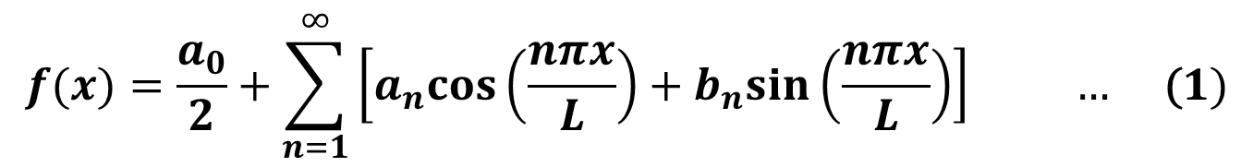
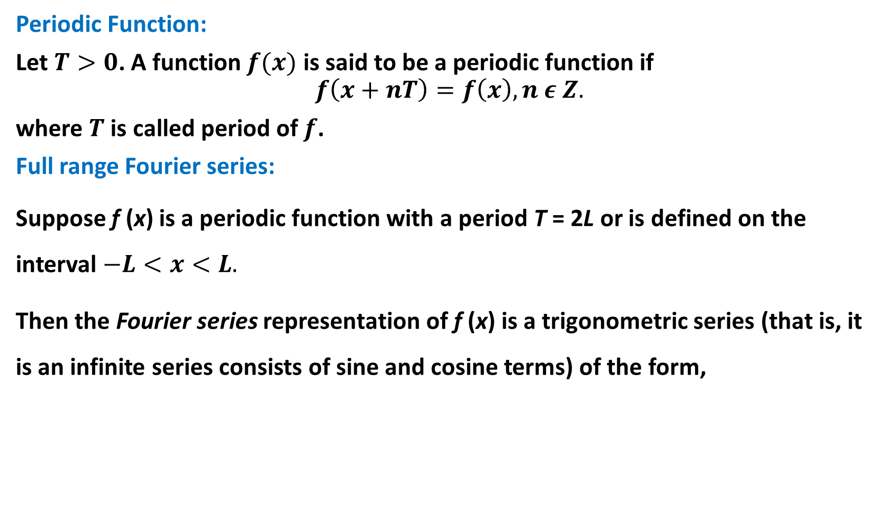
Periodic Function:
Let $T>0$. A function $f(x)$ is said to be a periodic function if
$$f\left(x+nT\right)=f\left(x\right), n ε Z.$$
where $T$ is called period of $f$.
Full range Fourier series:
Suppose f (x) is a periodic function with a period T = 2L or is defined on the interval $−L<x<L.$
Then the Fourier series representation of f (x) is a trigonometric series (that is, it is an infinite series consists of sine and cosine terms) of the form,
$$f(x)=\frac{a_{0}}{2}+\sum_{n=1}^{∞}{\left[a_{n}cos\left(\frac{nπx}{L}\right)+b_{n}sin\left(\frac{nπx}{L}\right)\right]} … \text{(}1)$$

Slide 6
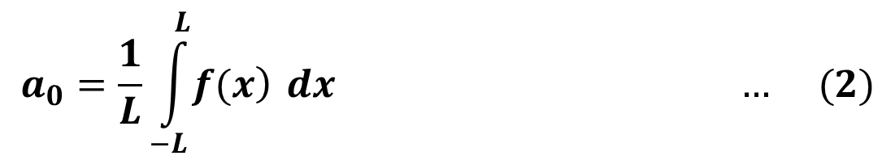

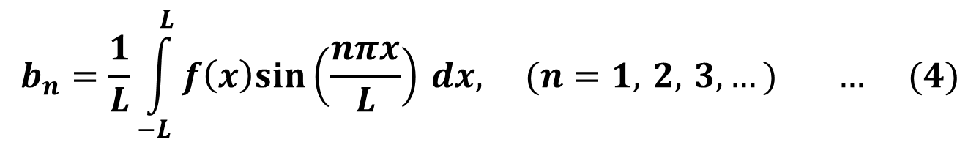
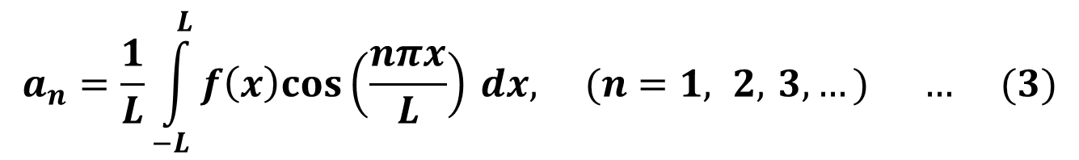
Where,
and
The coefficients $a_{0}, a_{n }$and $b_{n}$ are called the Fourier coefficients of f (x).
$$a_{0}=\frac{1}{L}\int_{−L}^{L}{\left.f(x\right)} dx … (2)$$
$$a_{n}=\frac{1}{L}\int_{−L}^{L}{f\left(x\right)cos\left(\frac{nπx}{L}\right)} dx, (n=1, 2, 3,…) … (3)$$
$$b_{n}=\frac{1}{L}\int_{−L}^{L}{f\left(x\right)sin\left(\frac{nπx}{L}\right)} dx, (n=1, 2, 3,…) … (4)$$

Slide 7

Some useful formulas:
$\sin{0=0}$
$\cos{0=1}$
$\sin{nπ}=0$
$\cos{nπ={(−1)}^{n}}$for all $nεℤ$.

Slide 8

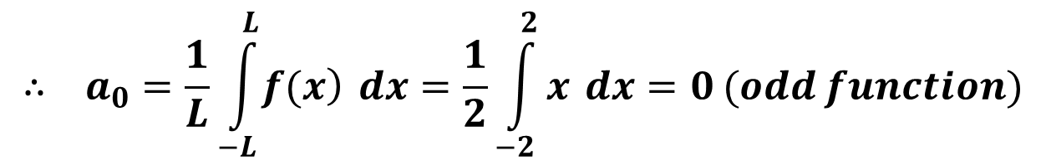
Example: Find a Fourier series for f (x) = x, −2 < x < 2, f (x + 4) = f (x).
Step 1: sketch the function
Step 2: Here $T=2L=4$, hence $L=2$
$$∴ a_{0}=\frac{1}{L}\int_{−L}^{L}{\left.f(x\right)} dx=\frac{1}{2}\int_{−2}^{2}{x} dx=0 (odd function)$$

Slide 9
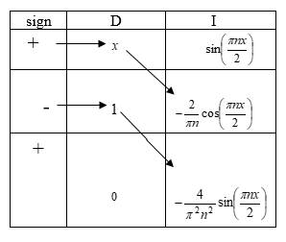
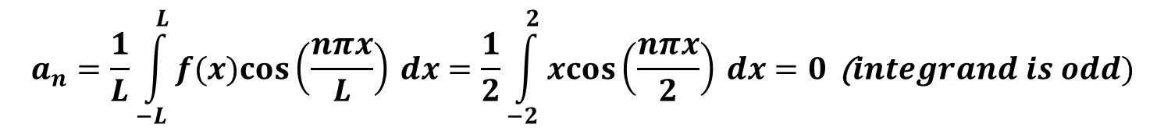
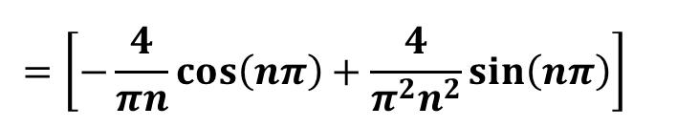
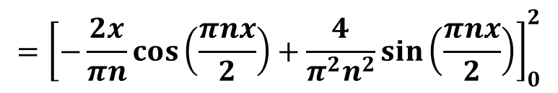

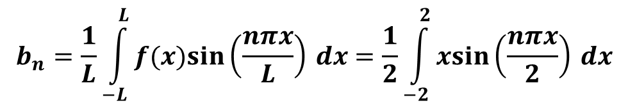
$$a_{n}=\frac{1}{L}\int_{−L}^{L}{f(x)cos\left(\frac{nπx}{L}\right)} dx=\frac{1}{2}\int_{−2}^{2}{xcos\left(\frac{nπx}{2}\right)} dx=0\text{ (}integrand is odd)$$
$$b_{n}=\frac{1}{L}\int_{−L}^{L}{f(x)sin\left(\frac{nπx}{L}\right)} dx=\frac{1}{2}\int_{−2}^{2}{xsin\left(\frac{nπx}{2}\right)} dx$$
$$=\int_{0}^{2}{xsin\left(\frac{nπx}{2}\right)} dx$$
$$={\left[−\frac{2x}{πn}cos\left(\frac{πnx}{2}\right)+\frac{4}{π^{2}n^{2}}sin\left(\frac{πnx}{2}\right)\right]}_{0}^{2}$$
$$={\left[−\frac{4}{πn}cos\left(nπ\right)+\frac{4}{π^{2}n^{2}}sin\left(nπ\right)\right]}_{}^{}$$

Slide 10


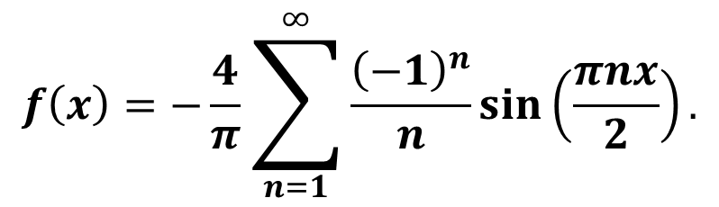
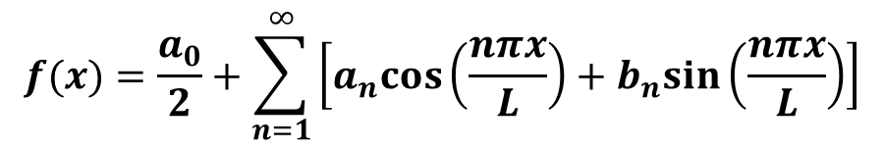
Step 3: Now, we know the Fourier series of $f(x)$ in the interval $−L<x<L$ is
So,
$$=−\frac{4}{πn}{\left(−1\right)}^{n}$$
$$f(x)=\frac{a_{0}}{2}+\sum_{n=1}^{∞}{\left[a_{n}cos\left(\frac{nπx}{L}\right)+b_{n}sin\left(\frac{nπx}{L}\right)\right]}$$
$$f\left(x\right)=−\frac{4}{π}\sum_{n=1}^{∞}{\frac{{\left(−1\right)}^{n}}{n}sin\left(\frac{πnx}{2}\right)}.$$

Slide 11

Example: Find the Fourier series expansion for the standard square wave
Solution:
Hence $T=2L=2, L=1$

Slide 13
Therefore the Fourier series of f(x) is

Slide 14
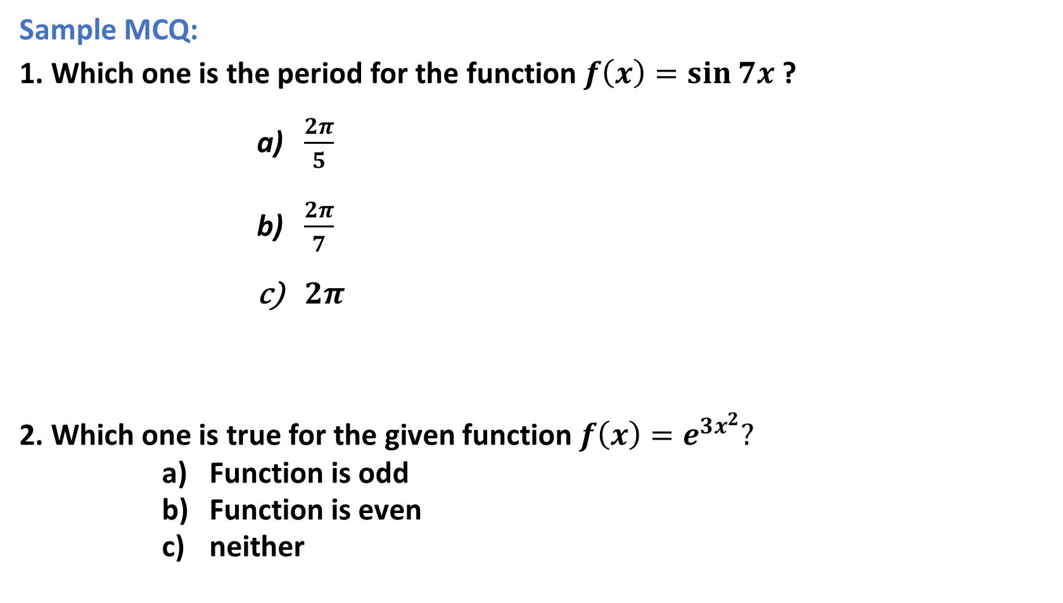
Sample MCQ:
1. Which one is the period for the function $f\left(x\right)=\sin{7x}$ ?
$\frac{2π}{5}$
$\frac{2π}{7}$
$2π$
2. Which one is true for the given function $f\left(x\right)=e^{3x^{2}}?$
Function is odd
Function is even
neither

Slide 15

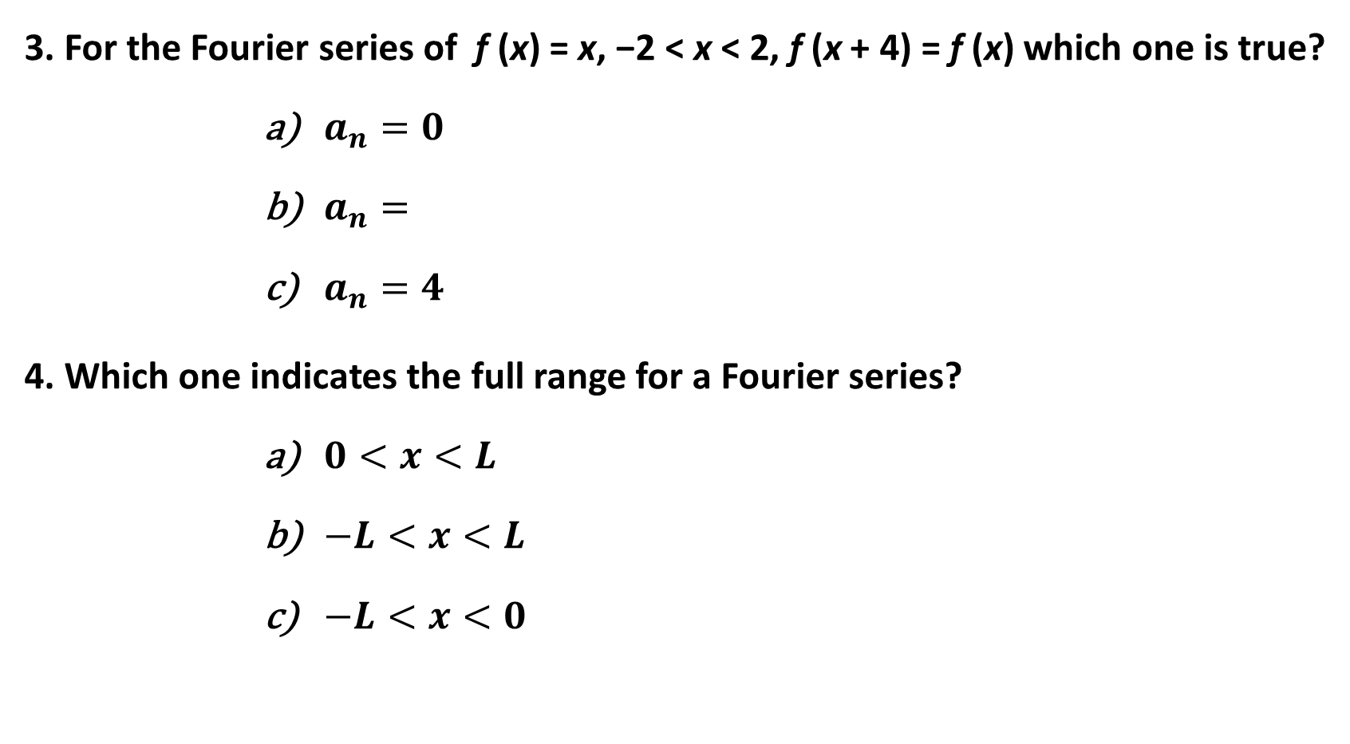
3. For the Fourier series of f (x) = x, −2 < x < 2, f (x + 4) = f (x) which one is true?
$a_{n}=0$
$a_{n}=$
$a_{n}=4$
4. Which one indicates the full range for a Fourier series?
$0<x<L$
$−L<x<L$
$−L<x<0$
$$\frac{4}{πn}{\left(−1\right)}^{n+1}$$

Slide 16
Outcome:
We can now identify even and odd function.
Periodic function and periodicity of a given function and we can also sketch a periodic function.
Now we can expand a periodic function in terms of an infinite sum of sines and (or) cosines, i.e. full range Fourier series in real form.

